Slide 1
Frequency Comb Generation via Physics-Informed Bayesian Optimization
Zheming Li, Lucas Fernandez-Alcazar, Arunn Suntharalingam,
Tsampikos Kottos

Slide 3
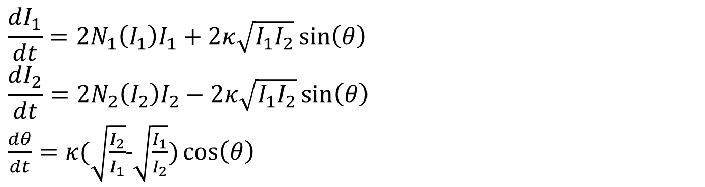
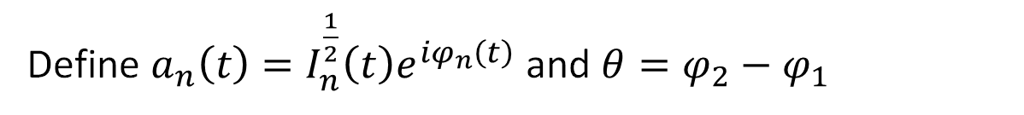
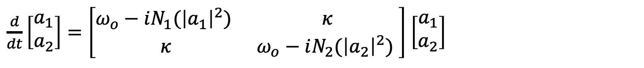
Coupled Mode Theory (CMT)
$\frac{d}{dt}\left[\begin{matrix}a_{1} \\ a_{2}\end{matrix}\right]=\left[\begin{matrix}ω_{o}−iN_{1}({\left|a_{1}\right|}^{2}) & κ \\ κ & ω_{o}−iN_{2}({\left|a_{2}\right|}^{2}) \end{matrix}\right]$ $\left[\begin{matrix}a_{1} \\ a_{2}\end{matrix}\right]$
Define $a_{n}\left(t\right)=I_{n}^{\frac{1}{2}}\left(t\right)e^{iφ_{n}\left(t\right)}$ and $θ=φ_{2}−φ_{1}$
$$\frac{dI_{1}}{dt}=2N_{1}\left(I_{1}\right)I_{1}+2κ\sqrt{I_{1}I_{2}}\sin\left(θ\right)$$
$$\frac{dI_{2}}{dt}=2N_{2}\left(I_{2}\right)I_{2}−2κ\sqrt{I_{1}I_{2}}\sin\left(θ\right)$$
$\frac{dθ}{dt}=κ(\sqrt{\frac{I_{2}}{I_{1}}}$-$\sqrt{\frac{I_{1}}{I_{2}}})\cos\left(θ\right)$

Slide 4
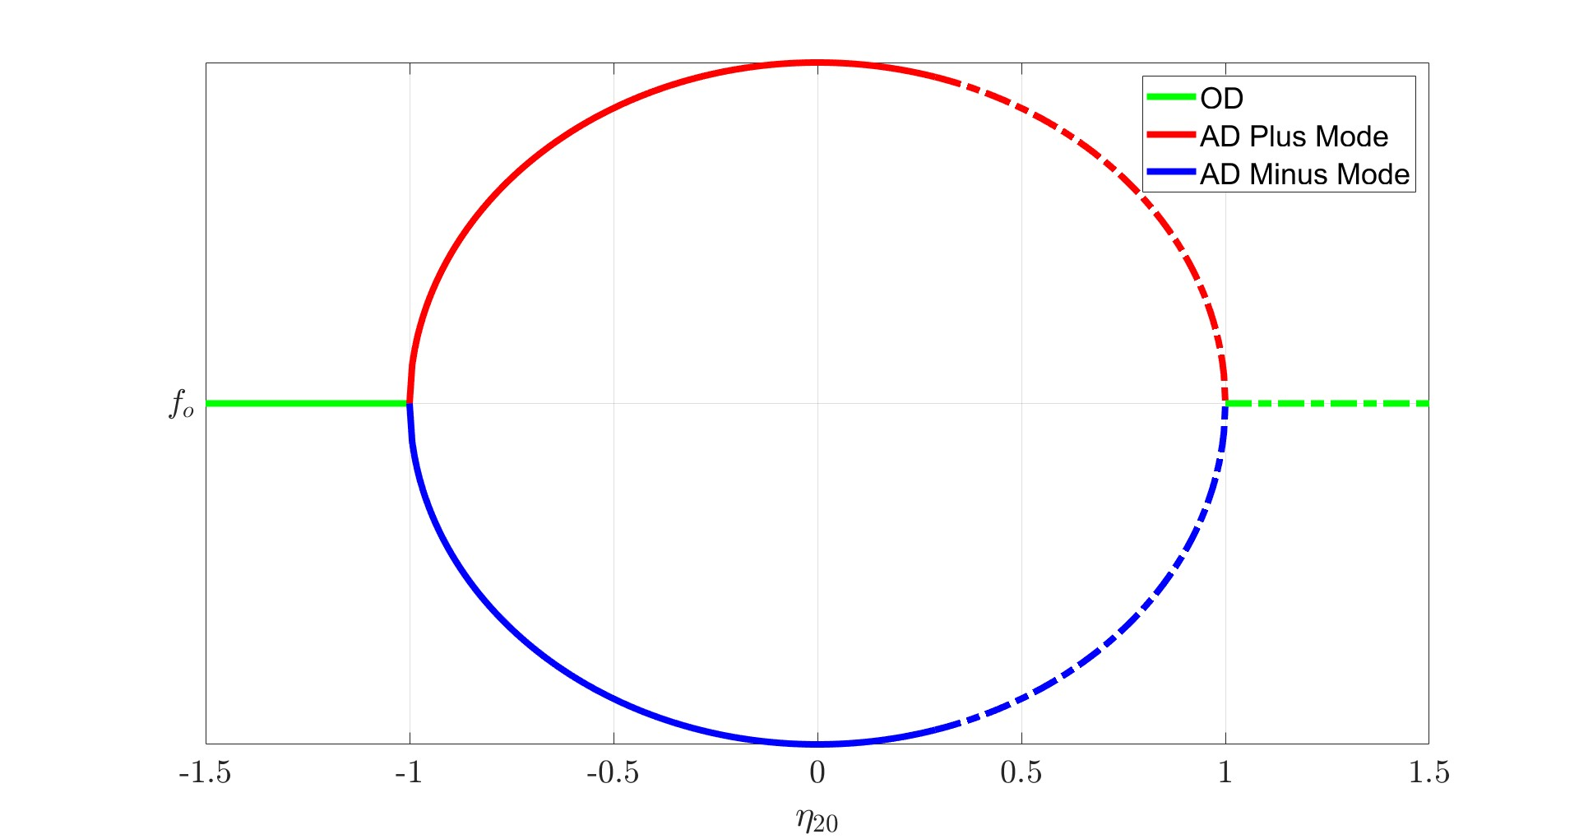

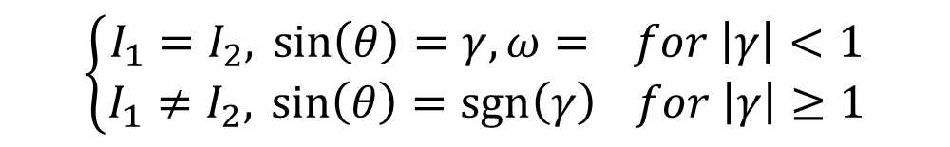
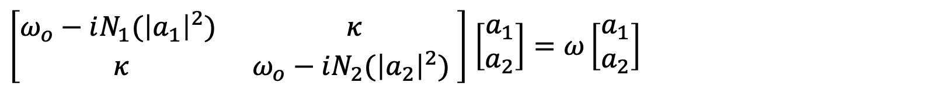
Nonlinear Supermodes (NS)
$\left[\begin{matrix}ω_{o}−iN_{1}({\left|a_{1}\right|}^{2}) & κ \\ κ & ω_{o}−iN_{2}({\left|a_{2}\right|}^{2}) \end{matrix}\right]$ $\left[\begin{matrix}a_{1} \\ a_{2}\end{matrix}\right]=ω\left[\begin{matrix}a_{1} \\ a_{2}\end{matrix}\right]$
Suppose $a_{n}(t)=A_{n}e^{iwt}$
The eigenmodes correspond to
$$\left\{\begin{aligned}I_{1}=I_{2},\sin\left(θ\right)=γ,ω= for \left|γ\right|<1 \\ I_{1}≠I_{2},\sin\left(θ\right)=\operatorname{sgn}\left(γ\right) for \left|γ\right|≥1\end{aligned}\right.$$
Where $γ=\frac{N_{2}\left(I_{2}\right)−N_{1}\left(I_{1}\right)}{2κ}$
Notes:
Add AD/OD frequency plot

Slide 5
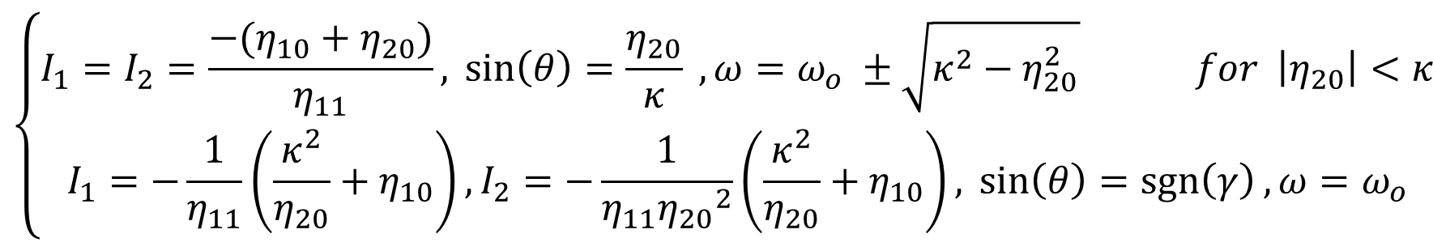
Substituting Nonlinearities
Let $N_{1}\left(I_{1}\right)=η_{11}I_{1}+η_{10}$, $N_{2}\left(I_{2}\right)=η_{20}$
Solving for the fixed points, i.e. $\frac{dI_{1}}{dt}$= $\frac{dI_{2}}{dt}$= $\frac{dθ}{dt}=0$,
$$\left\{\begin{aligned}I_{1}=I_{2}=\frac{−(η_{10}+η_{20})}{η_{11}},\sin\left(θ\right)=\frac{η_{20}}{κ} ,ω=ω_{o} ±\sqrt{κ^{2}−η_{20}^{2}} for \left|η_{20}\right|<κ \\ I_{1}=−\frac{1}{η_{11}}\left(\frac{κ^{2}}{η_{20}}+η_{10}\right), I_{2}=−\frac{1}{η_{11}{η_{20}}^{2}}\left(\frac{κ^{2}}{η_{20}}+η_{10}\right),\sin\left(θ\right)=\operatorname{sgn}\left(γ\right),ω=ω_{o}\end{aligned}\right.$$
The stability of the supermodes are determined by evaluating the eigenvalues of Jacobian matrix at the fixed points.

Slide 6
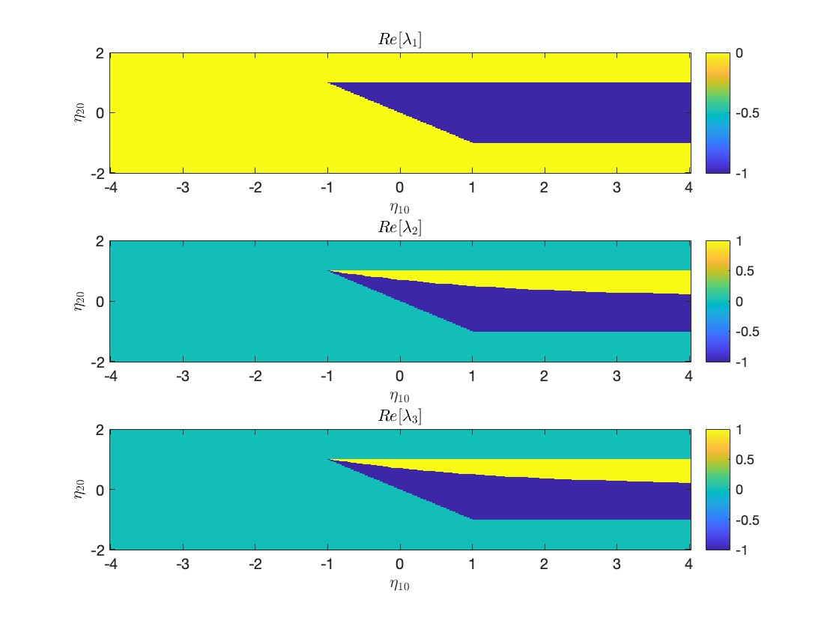
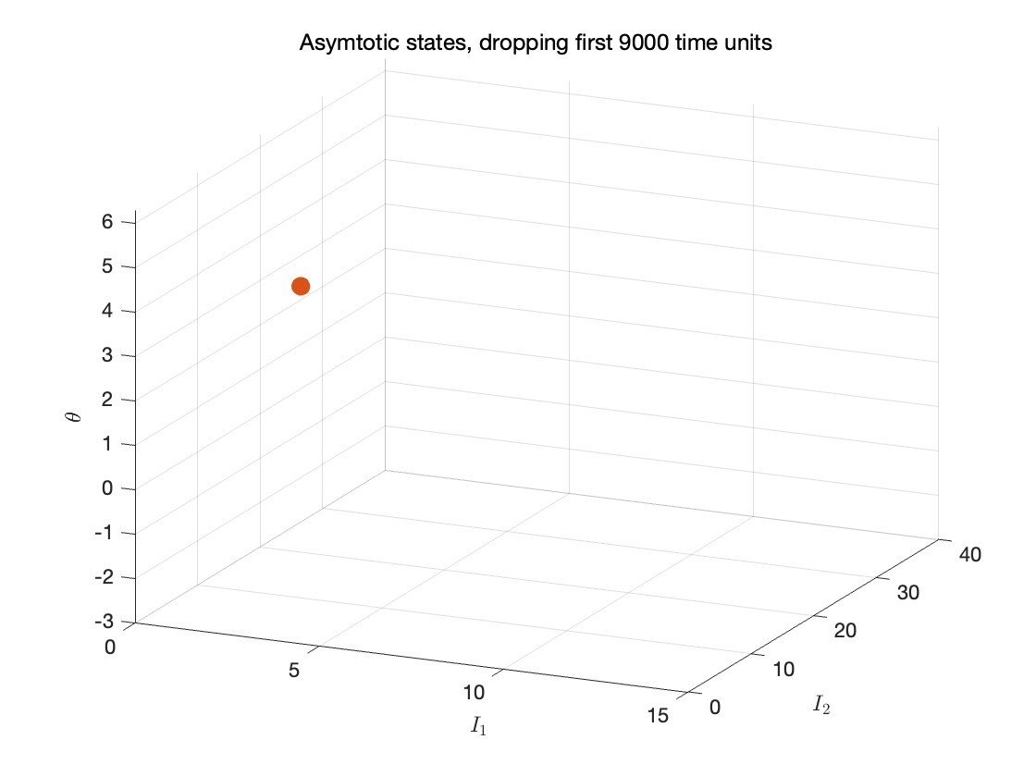
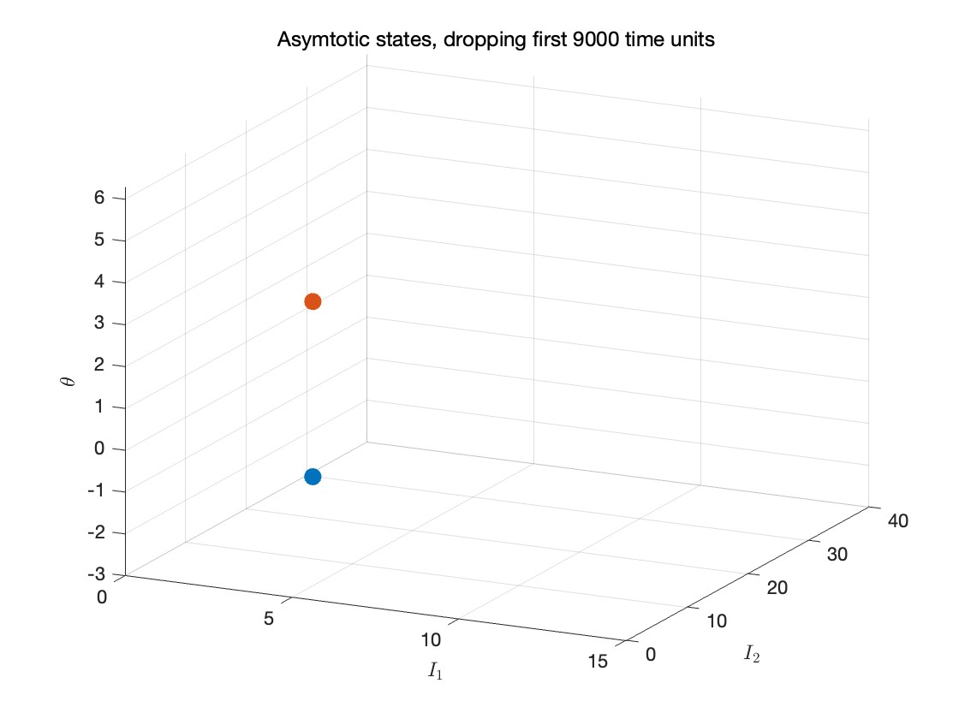
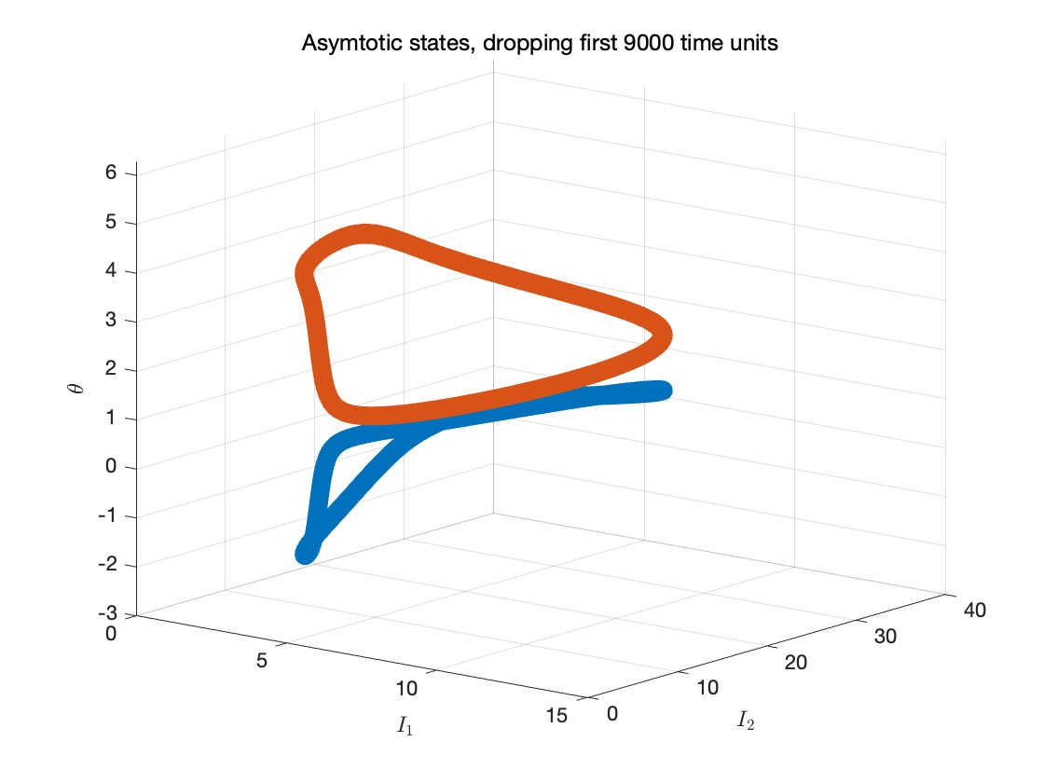
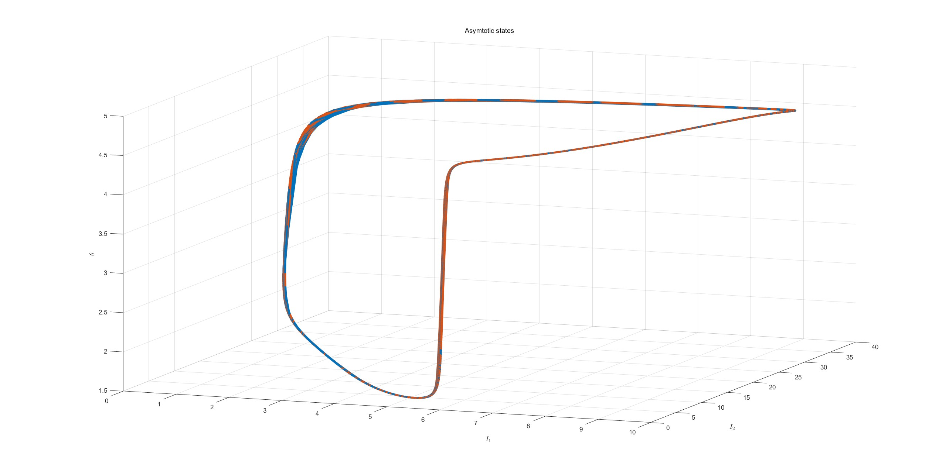
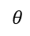
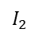
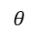
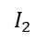

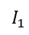
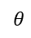
Fixing $\left(η_{11}, κ\right)=(−0.5, 1)$
a.
Dynamical State Classification
III, IV
Trivial/Unbounded Regions
II
I
b.
I. Single OD
II. Two AD
III. Two Limit Cycle
IV. Single Limit Cycle
$$θ$$
$$θ$$
$$θ$$
$$θ$$
$$I_{2}$$
$$I_{2}$$
$$I_{1}$$
$$I_{2}$$
$$I_{2}$$
$$I_{1}$$
$$I_{1}$$
$$I_{1}$$
Notes:
Add text for hopf bifurcation and EP

Slide 7
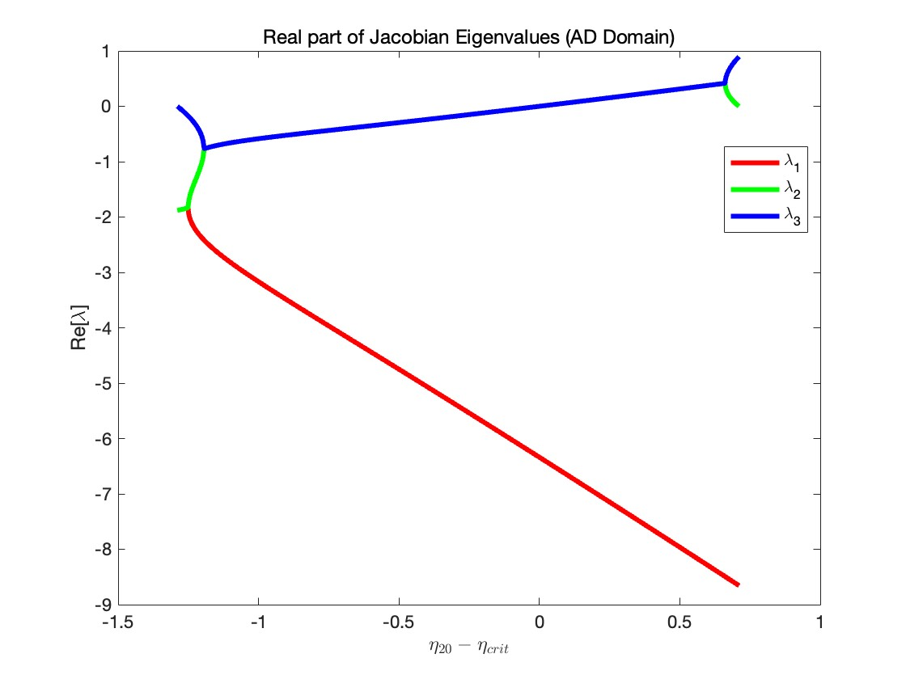
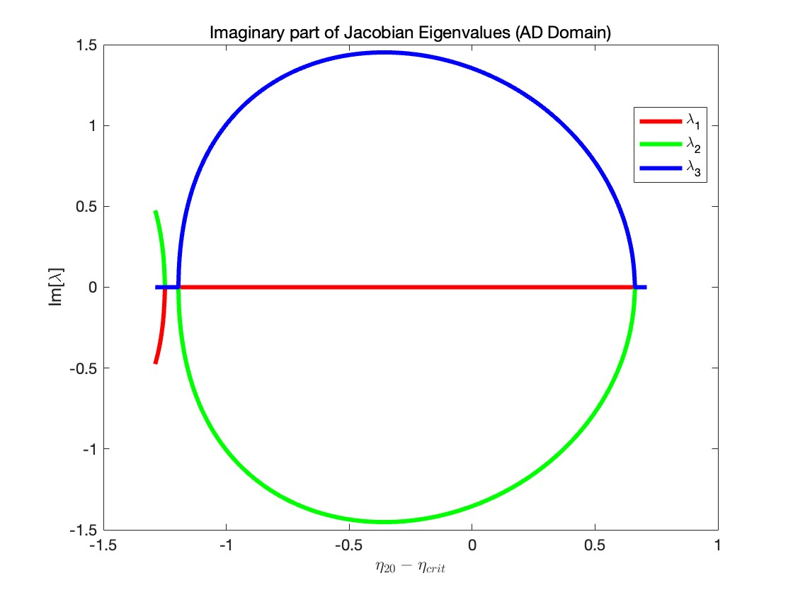
Jacobian Eigenvalues
Fixing $η_{10}=2.88$
I
II
III
IV
Unbounded
I
II
III
IV
Unbounded
Notes:
Add dashed line at 0

Slide 8
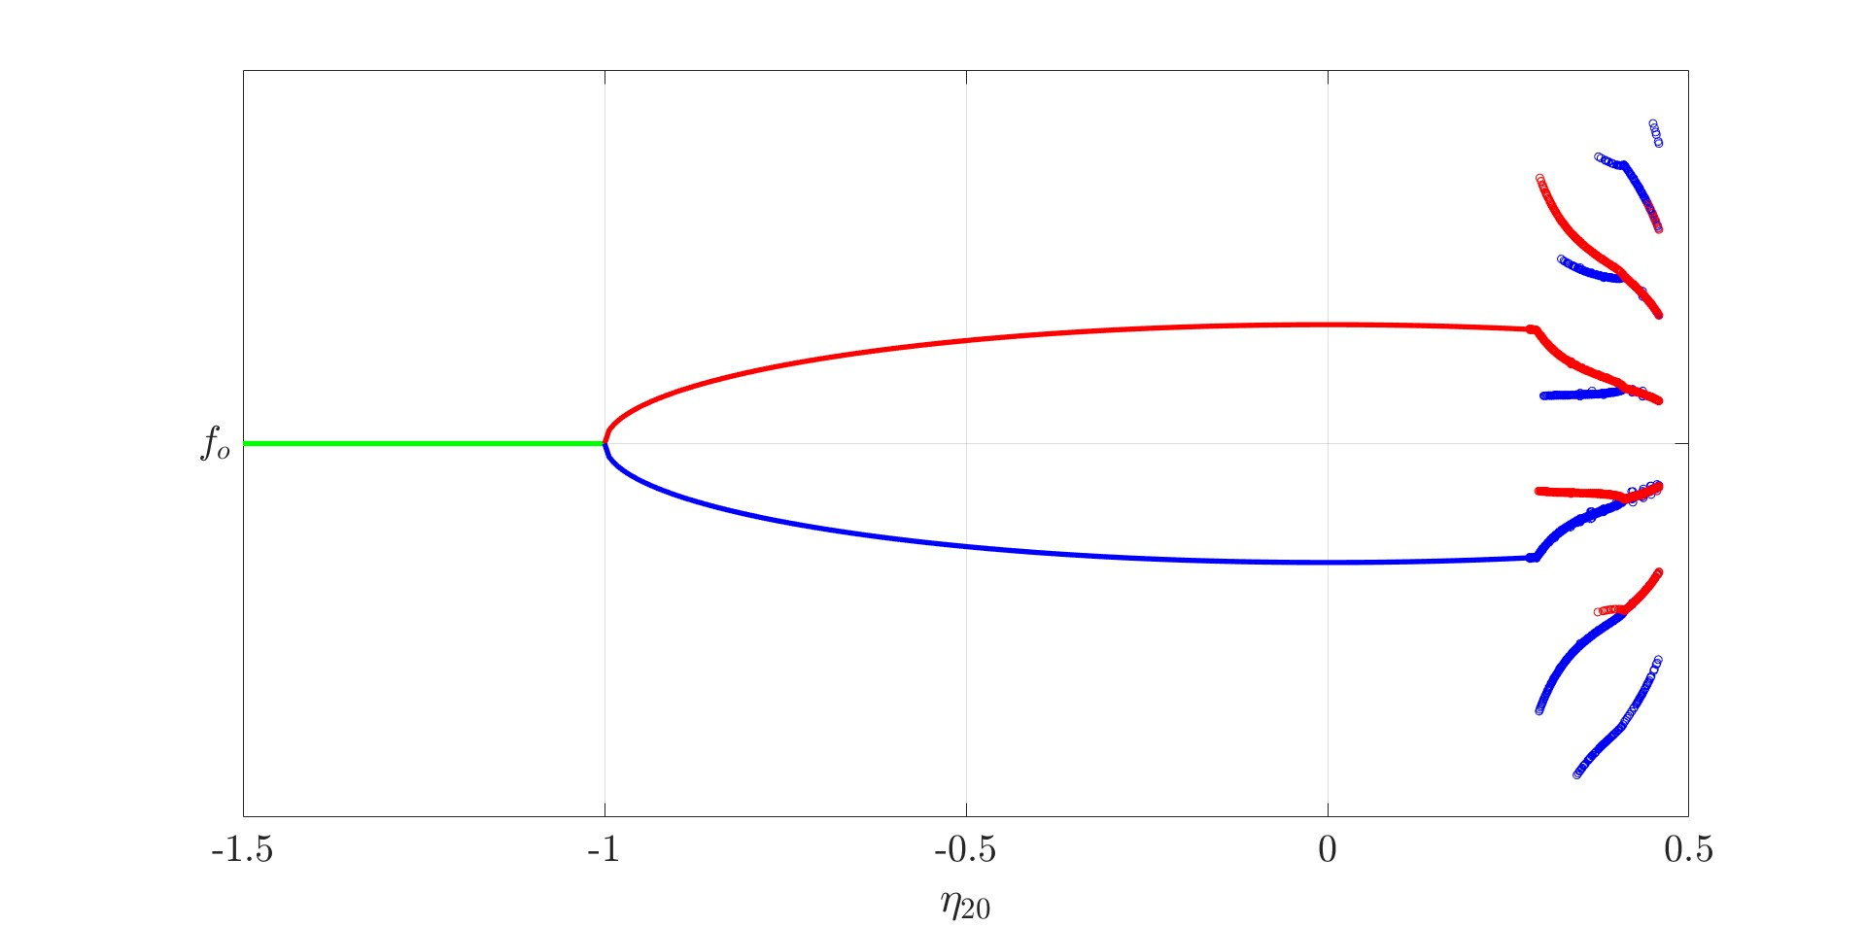
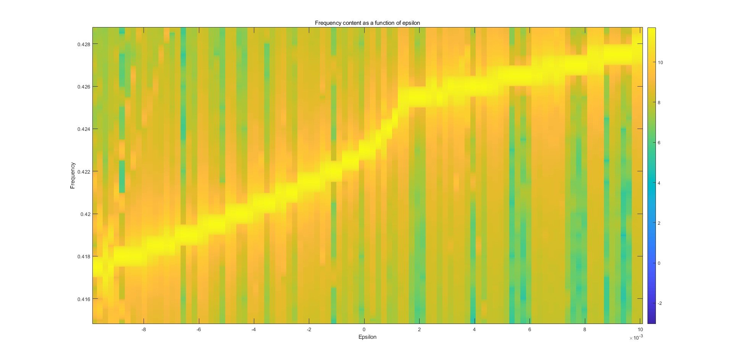
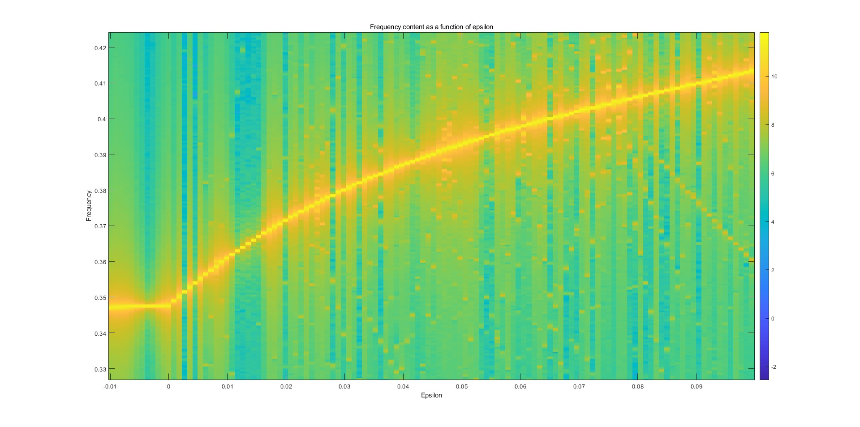
Characteristic Frequencies
I
II
III
IV
EP

Slide 9
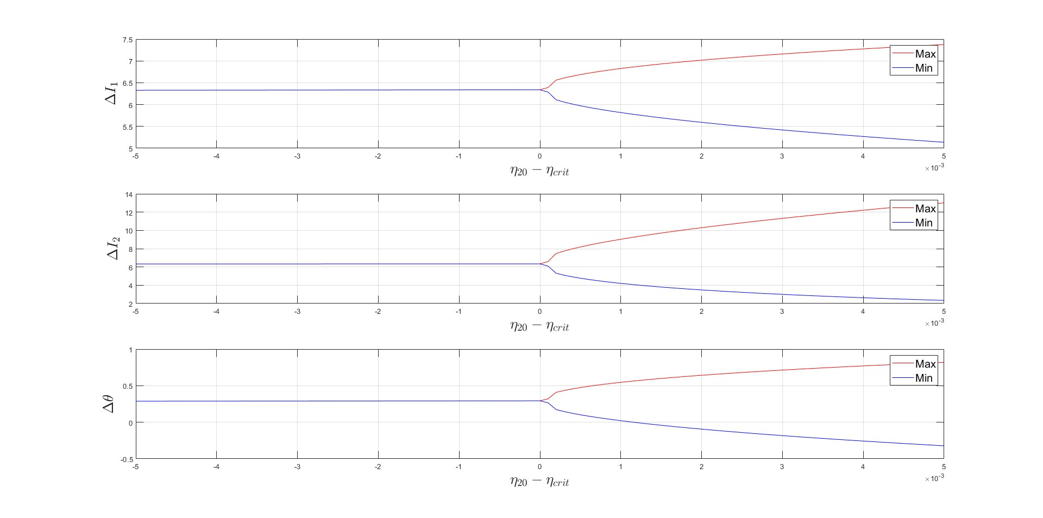
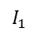
Amplitude Scaling of Limit Cycles
III. Two Limit Cycle
$$θ$$
$$I_{1}$$
$$I_{2}$$

Slide 10
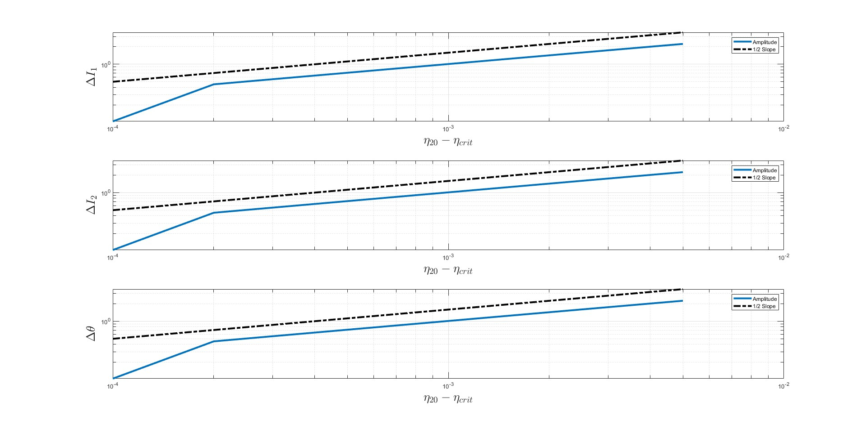
Amplitude Scaling of Limit Cycles

Slide 11
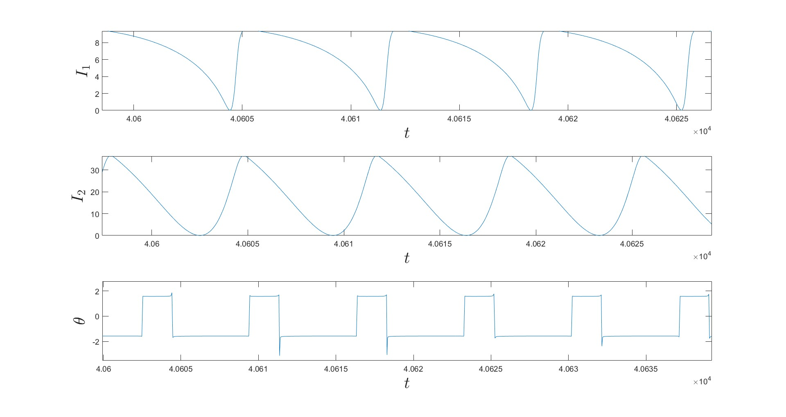
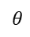
Relaxation Oscillations (Single LC)
IV. Single Limit Cycle
$$θ$$
$$I_{1}$$
$$I_{2}$$
Notes:
Add parametric plot

Slide 12
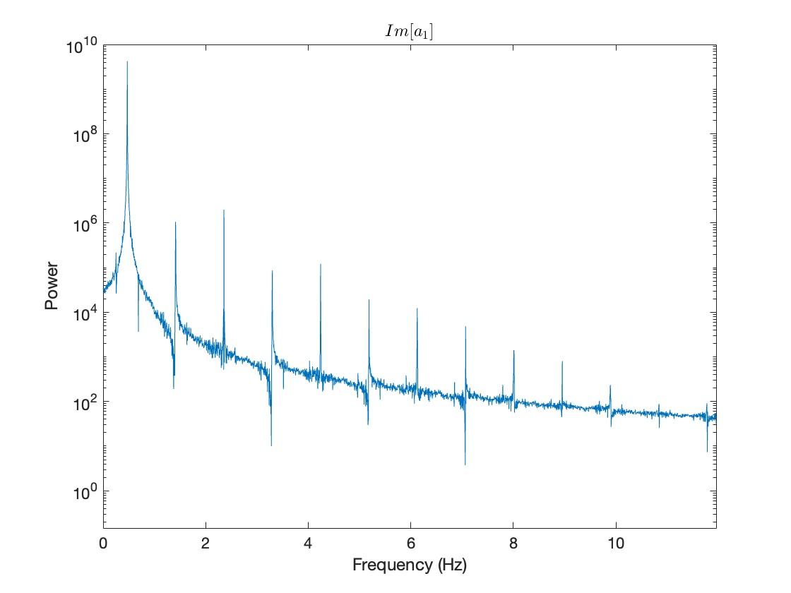
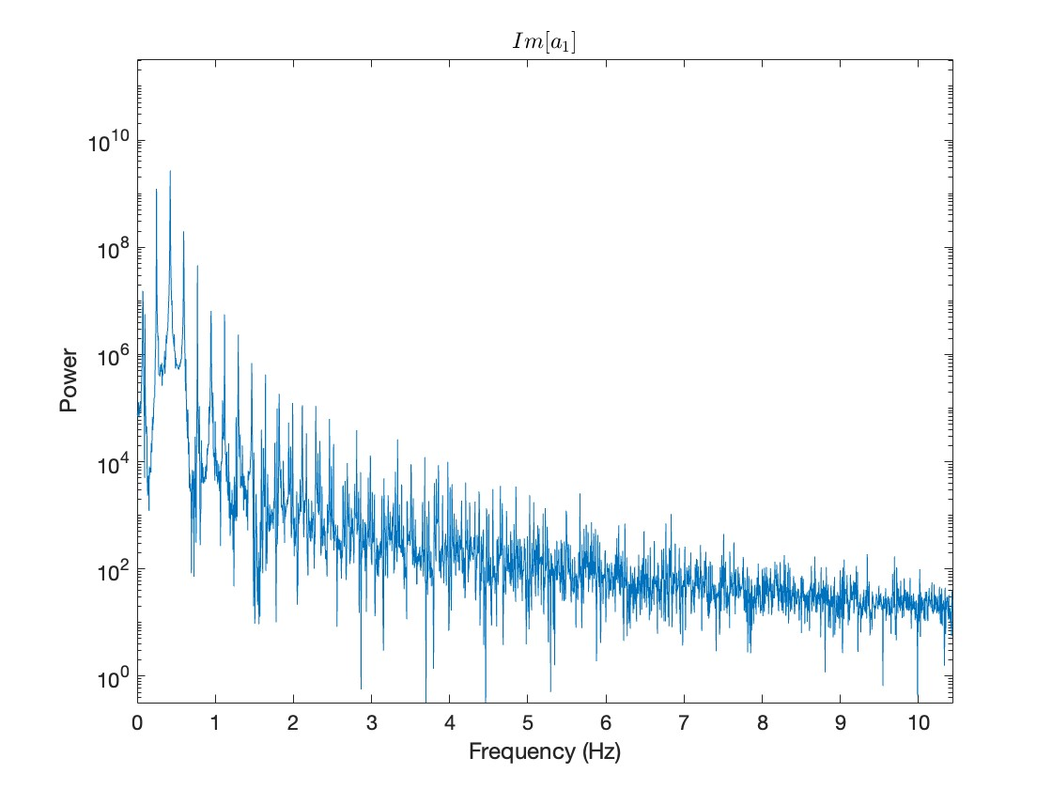

Slide 13
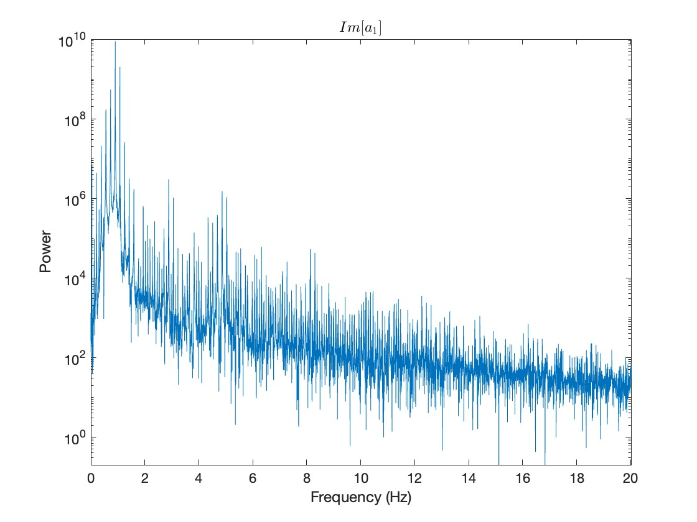
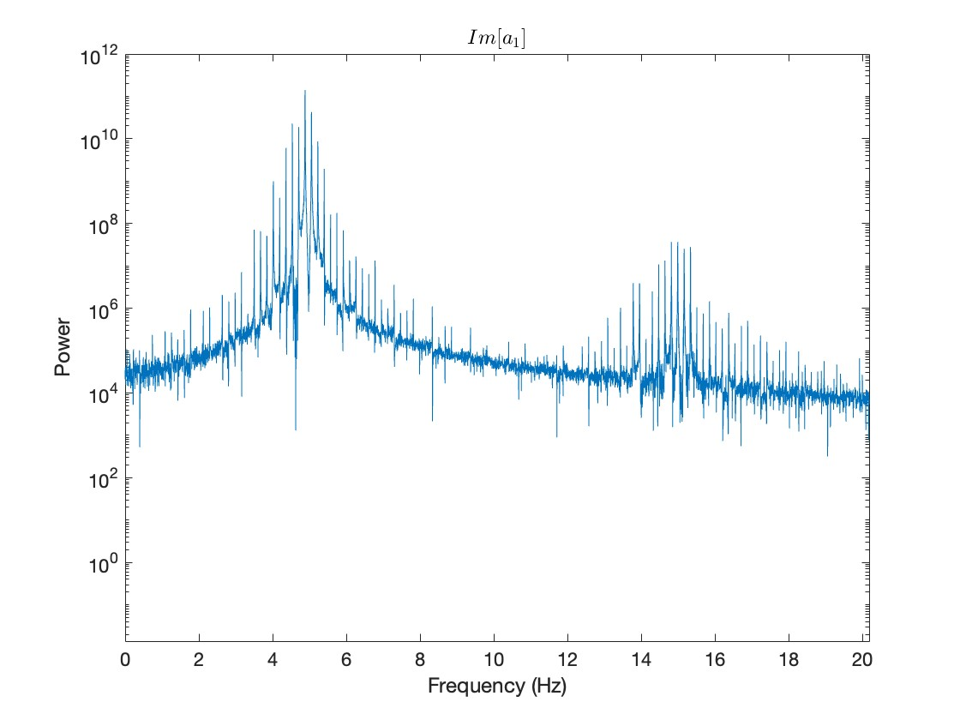

Slide 14
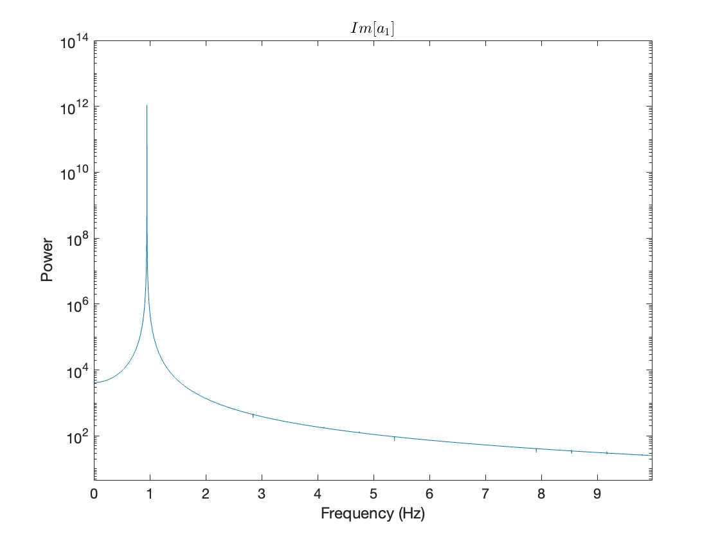
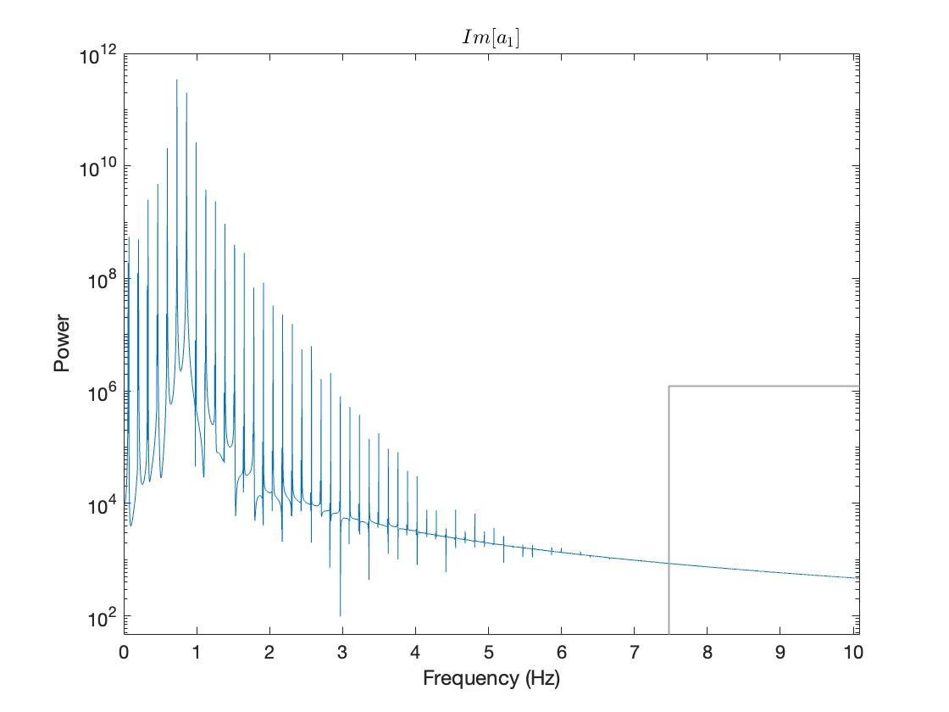
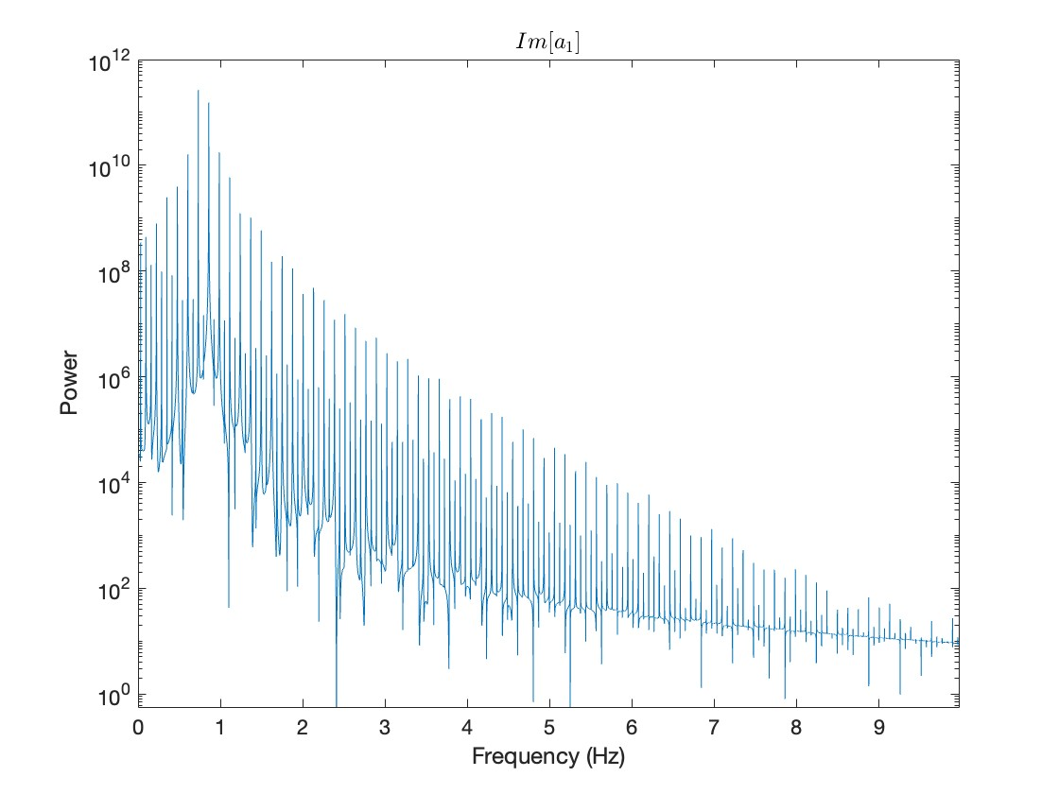

Slide 15
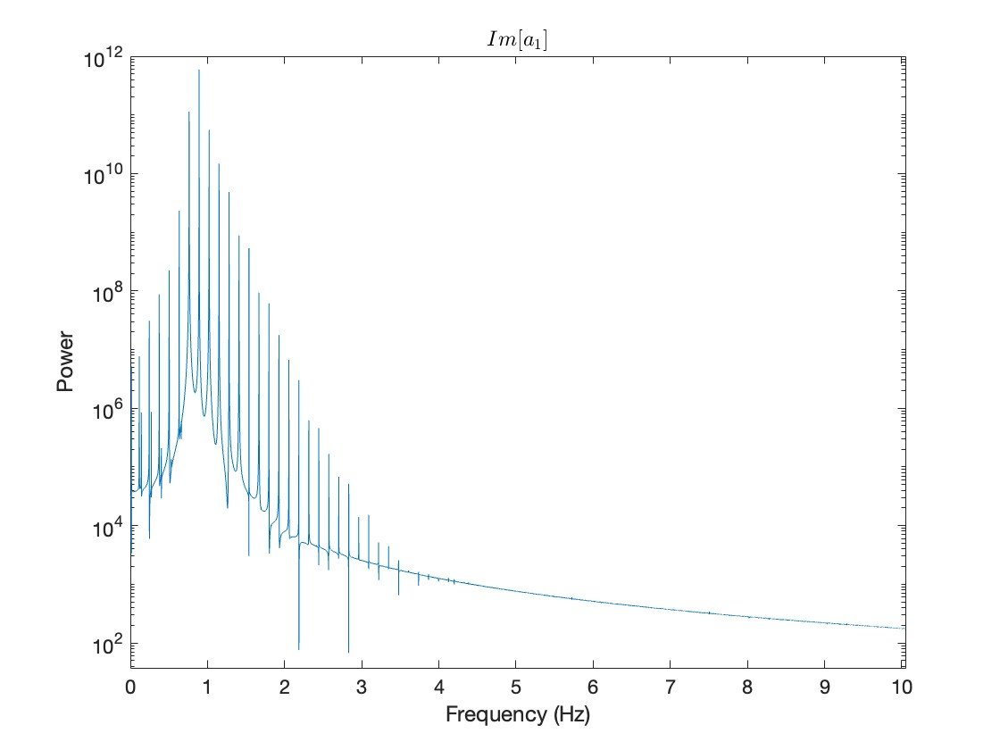
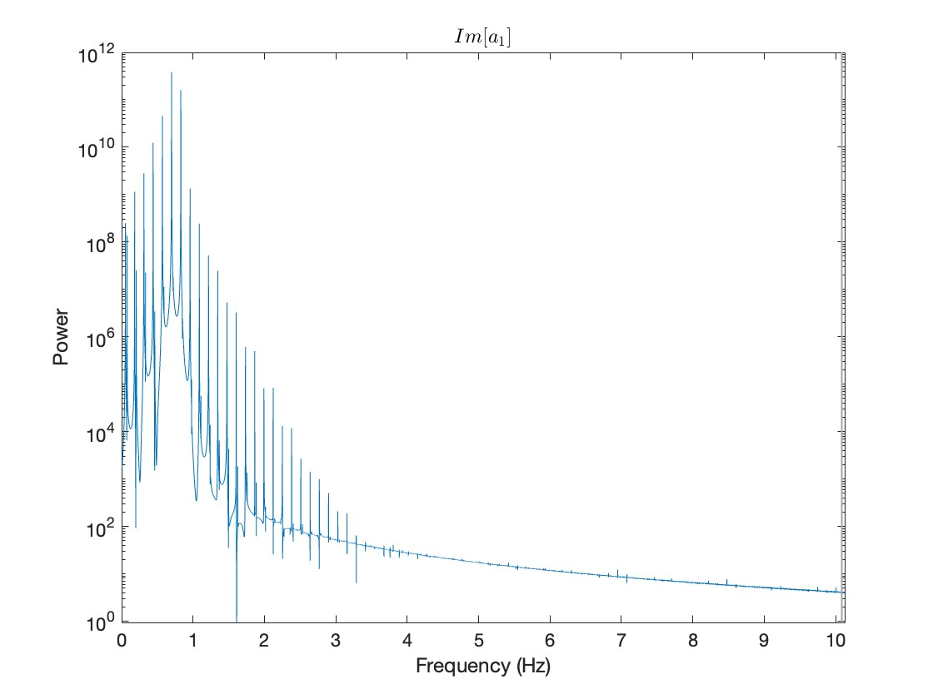
W2 = w1
W2 = 1.1w1
W2 = 0.9w1

Slide 16
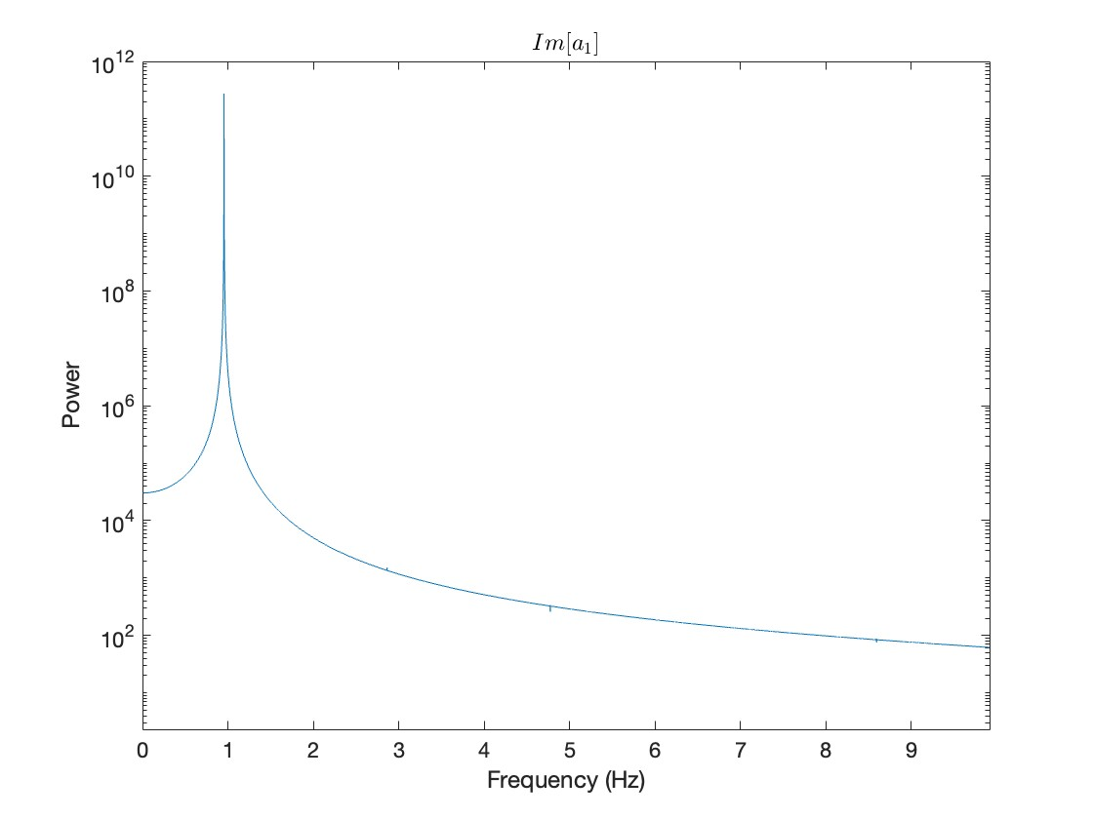
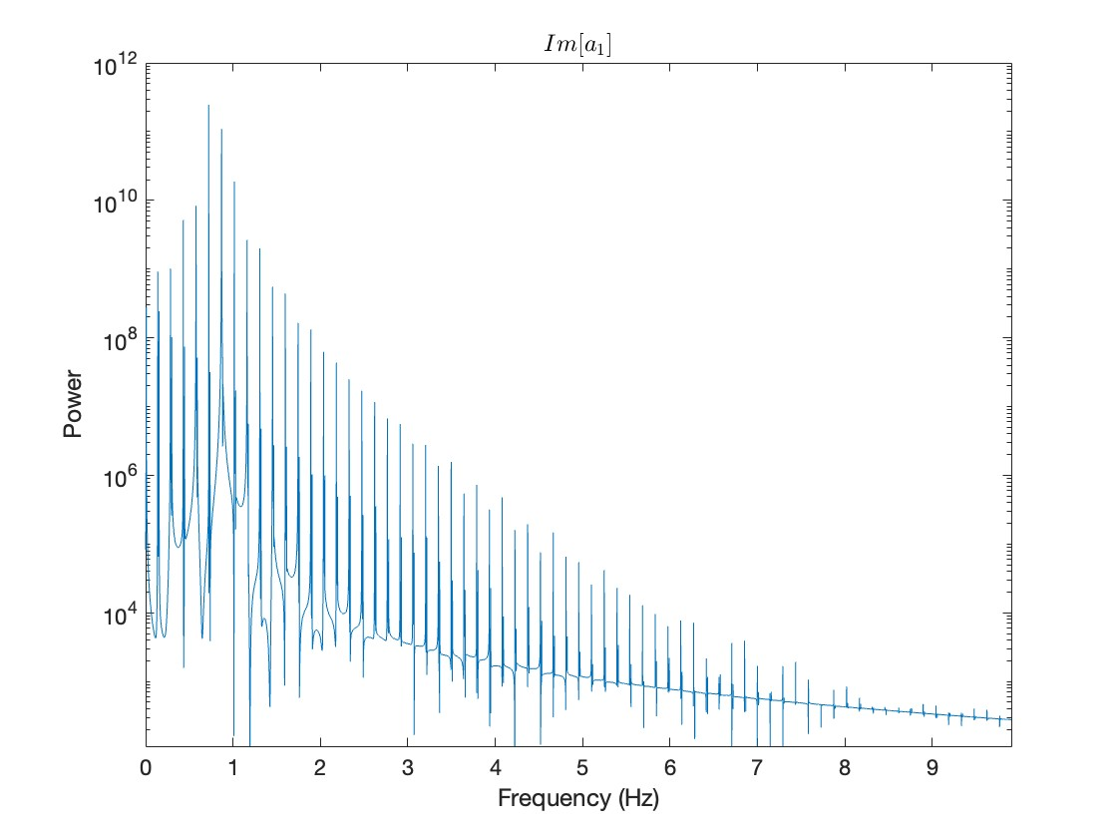
Cubic Nonlinearity
n20= 0
n20= 0.33
n20= 0.289

Slide 17
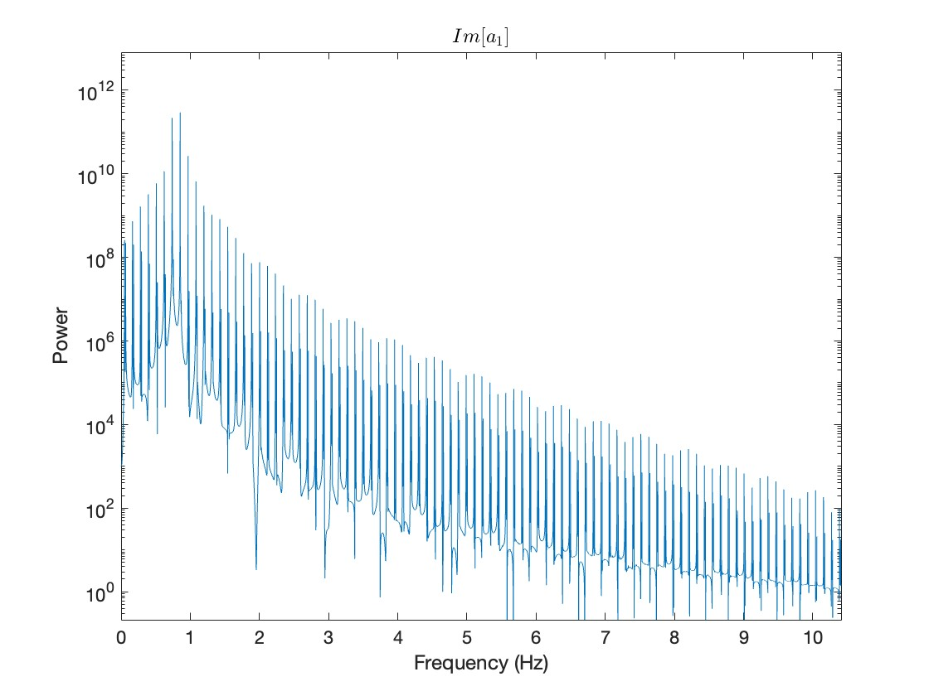

Slide 18
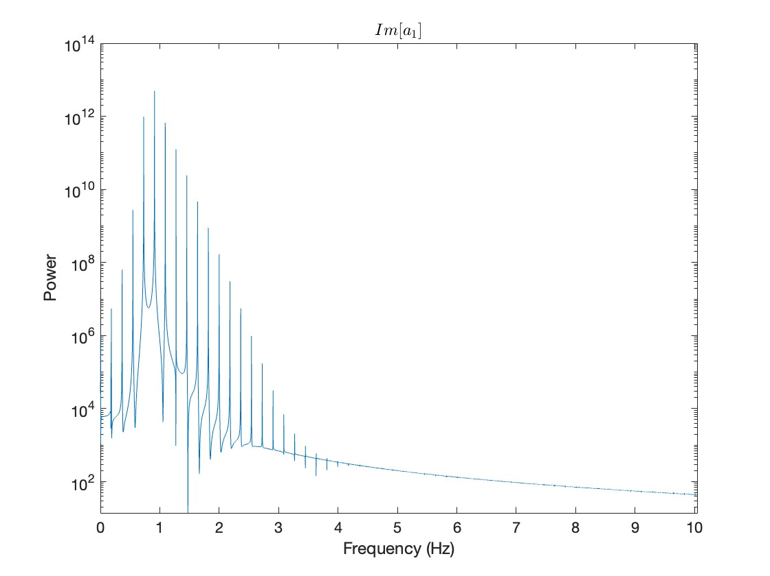
0.215
0.2365

Slide 19
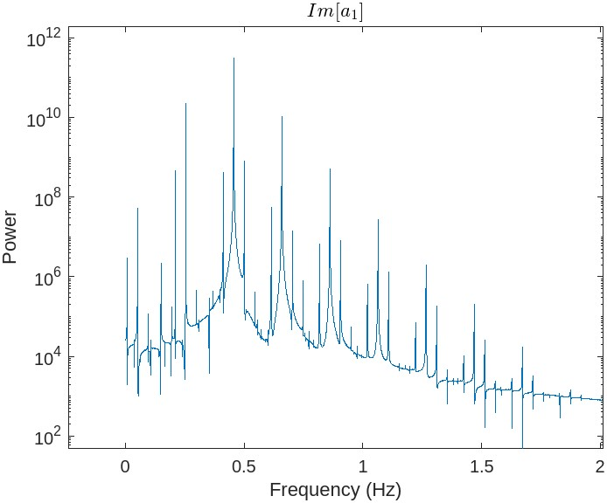
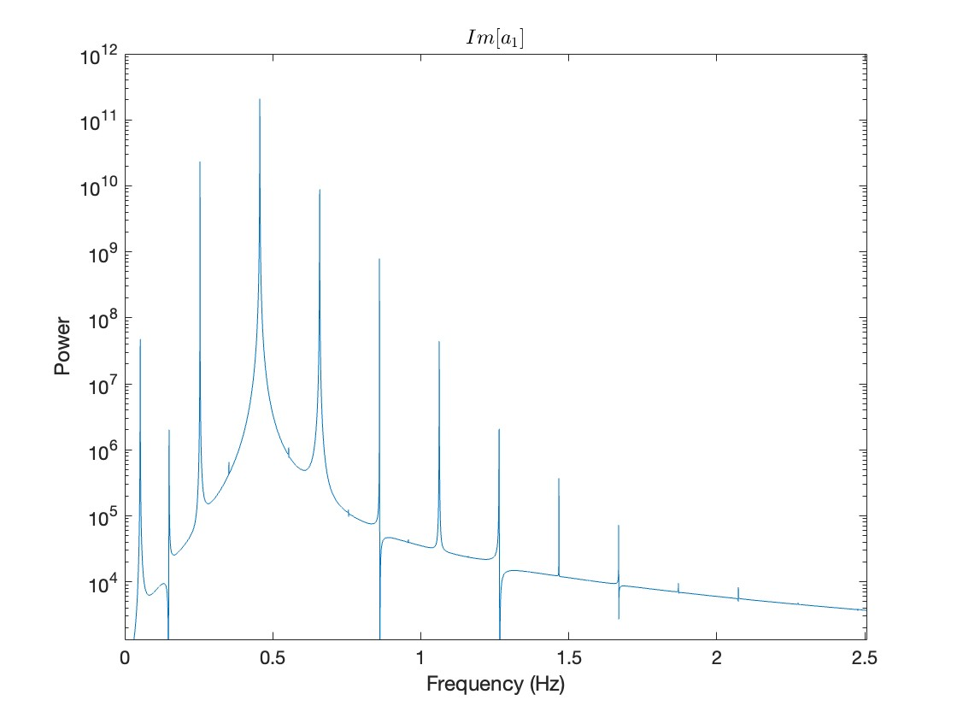
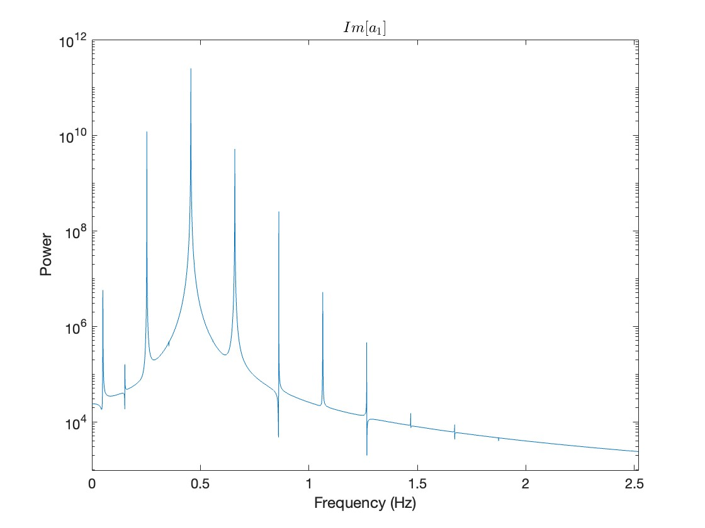
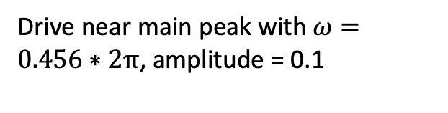
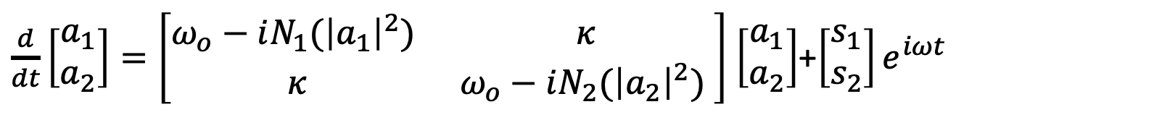
Driving
$\frac{d}{dt}\left[\begin{matrix}a_{1} \\ a_{2}\end{matrix}\right]=\left[\begin{matrix}ω_{o}−iN_{1}({\left|a_{1}\right|}^{2}) & κ \\ κ & ω_{o}−iN_{2}({\left|a_{2}\right|}^{2}) \end{matrix}\right]$ $\left[\begin{matrix}a_{1} \\ a_{2}\end{matrix}\right]$+$\left[\begin{matrix}s_{1} \\ s_{2}\end{matrix}\right]e^{iωt}$
Limit cycle with n20 = 0.3, zero driving
Drive near main peak with $ω=0.456∗2π$, amplitude = 0.1

Slide 20
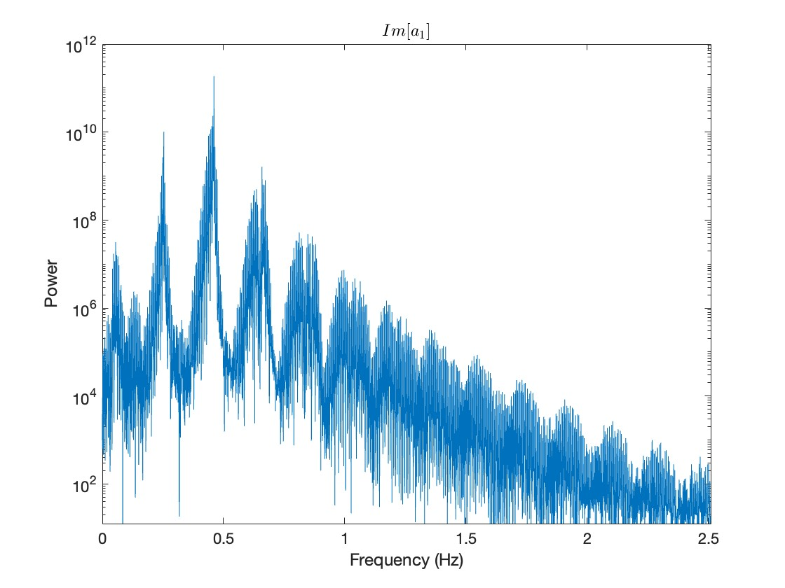
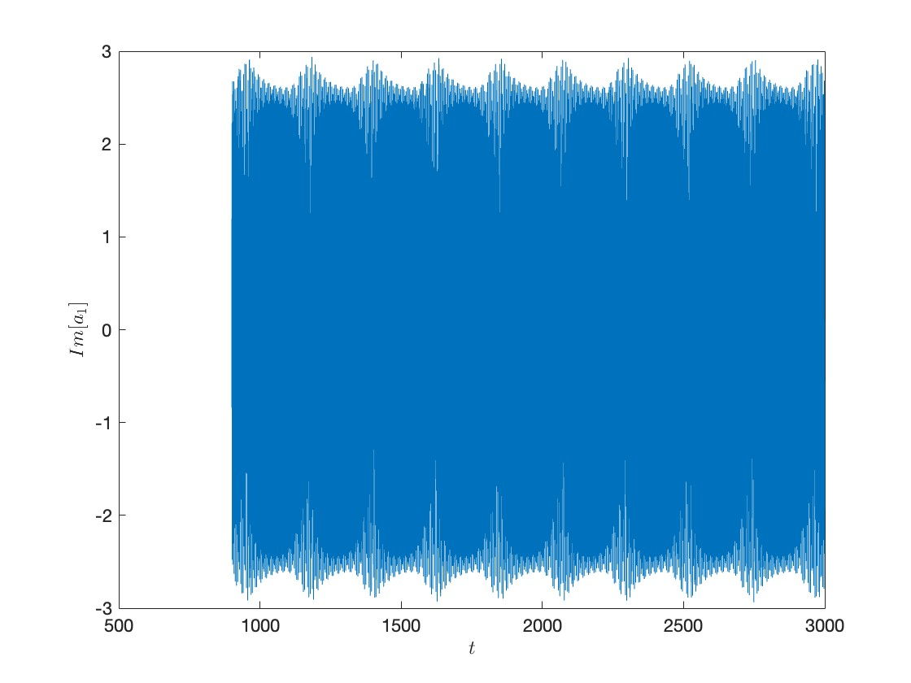
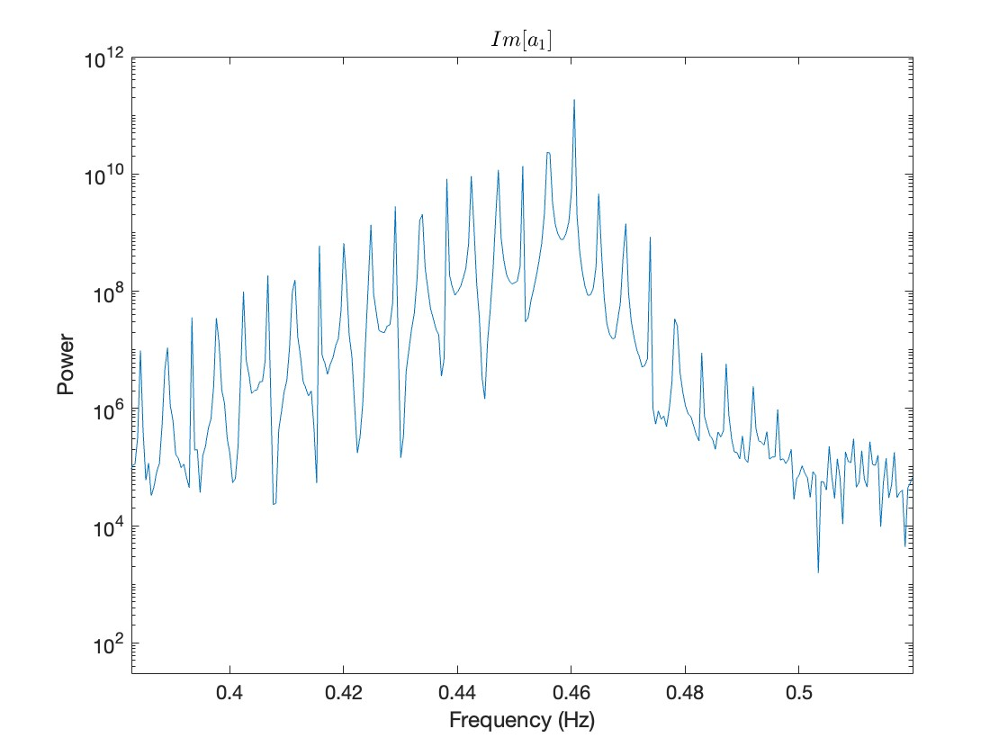
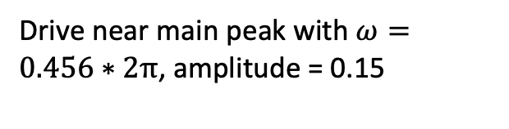
Driving
Drive near main peak with $ω=0.456∗2π$, amplitude = 0.15

Slide 21



Driving
Drive near main peak with $ω=0.456∗2π$, amplitude = 0.2

Slide 22


Driving
Drive near main peak with $ω=0.456∗2π$, amplitude = 0.25

Slide 23





Two Parameter Optimization (Linear gain coefficients)
$$Cost=\sqrt{\frac{\sum_{n=1}^{N}{{(p_{n}−μ)}^{2}}}{N}} where μ=\frac{1}{N}\sum_{n=1}^{N}{p_{n}}$$
$$Cost=\frac{p_{1}}{p_{2}}$$
$$\min_{η_{10},η_{20}}{cost}=1$$
i.e. symmetric around resonance frequency $ω_{o}$
$\min_{η_{10},η_{20}}{cost}=0.2678$ with N=4

Slide 24




Two Parameter Optimization (Linear gain coefficients)
$$Cost=\left|target−gap\right|$$
For target = 0.3
For target = 0.1
$$\min_{η_{10},η_{20}}{cost}=0.0918$$
$\min_{η_{10},η_{20}}{cost}=0.0006$

Slide 25




Four Parameter Optimization
Optimizing linear gains, second order and third order loss coefficients
$$Cost=\sqrt{\frac{\sum_{n=1}^{N}{{(p_{n}−μ)}^{2}}}{N}} where μ=\frac{1}{N}\sum_{n=1}^{N}{p_{n}}$$
For target = 0.3
$\min_{η_{10},η_{20}, η_{11}, η_{21}}{cost}=0.075$ for N=4

Slide 26




Five Parameter Optimization
$$Cost=\sum_{n=1}^{N}{p_{1}−p_{n}}$$
$\min_{η_{10},η_{20}, η_{11}, η_{21},η_{31} }{cost}=0.742$ for N=8

Slide 27

Optimize Driving Only
Zero Driving
Cost=0.43
D1 = 0.2
Omega = 1.58
Cost = 0.2

Slide 28





Fixed Point Region
$ν=0$.5
$$ν=0$$

Slide 29






Fixed Point Region
$$ν=1$$
$$ν=0.7$$

Slide 30





Limit Cycle Region
$ν=0$.1
$$ν=0$$

Slide 31








Limit Cycle Region
$ν=0$.5
$ν=0$.4

Slide 32


Slide 33




